Slide 1
RATINGS PREDICTION

Slide 2
1. Problem Definition:
We have a client who has a website where people write different reviews for technical products. Now they are adding a new feature to their website i.e. The reviewer will have to add stars(rating) as well with the review. The rating is out 5 stars and it only has 5 options available 1 star, 2 stars, 3 stars, 4 stars, 5 stars. Now they want to predict ratings for the reviews which were written in the past and they don’t have a rating. So, we have to build an application which can predict the rating by seeing the review.

Slide 3
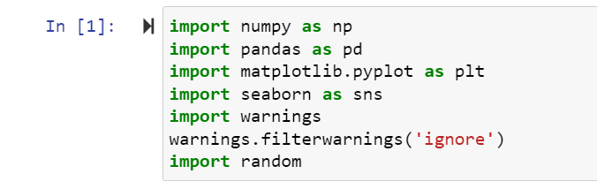
Dataset:

Slide 4
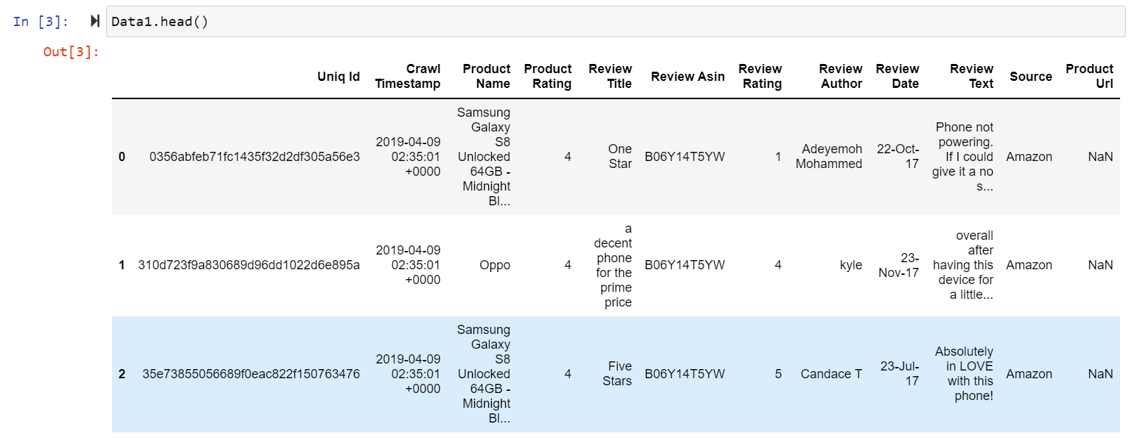

Slide 5
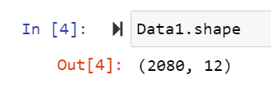
2. Data Analysis:
Check the how much columns and rows present in dataset using df.shape() is use to check the rows and columns count in this above dataset there are 2080 rows and 12 columns are present in dataset.

Slide 6
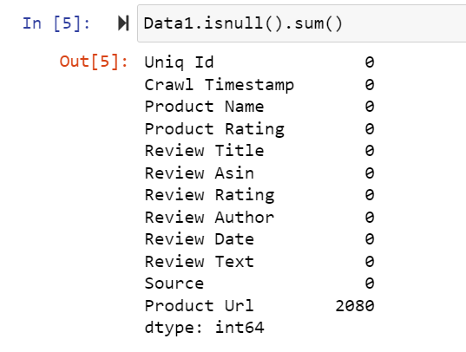
Check the null values present in dataset or not:
Check the how much missing values present in dataset using df.isnull() is use to check the missing values in dataset in this dataset there are missing values are present in this dataset product Url column.

Slide 7

In above Product Url column is drop because all null values are present in this column.

Slide 8
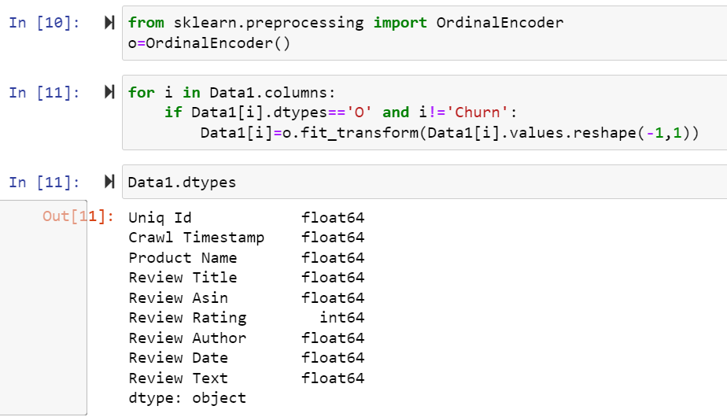
3.Data Preprocessing:
Here use label encoder to replace the categorical values into numeric in this dataset.

Slide 9
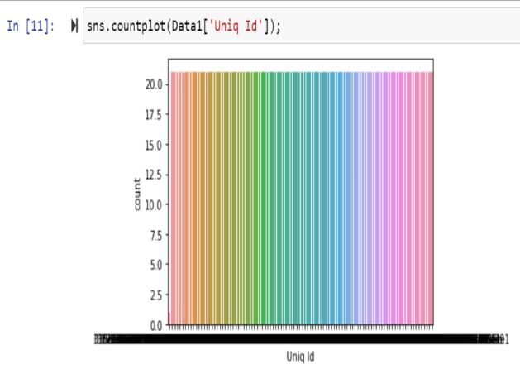
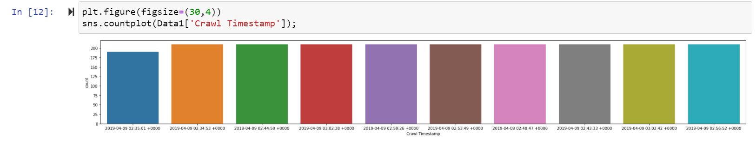
4. EDA: Univarient Analysis of Dataset:
Univarient analysis of ‘Unique Id‘Crawl Timestamp’ column in thisdataset.

Slide 10
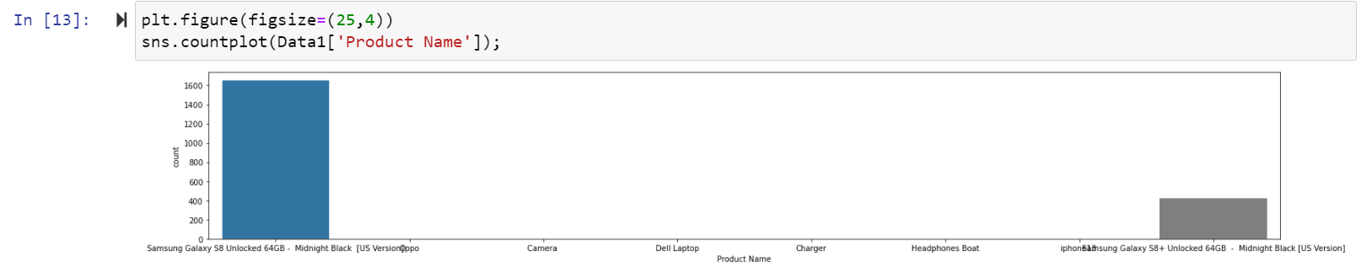
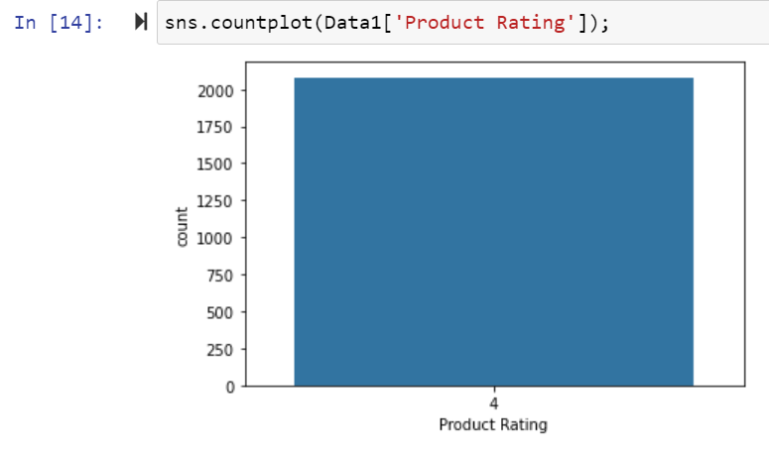
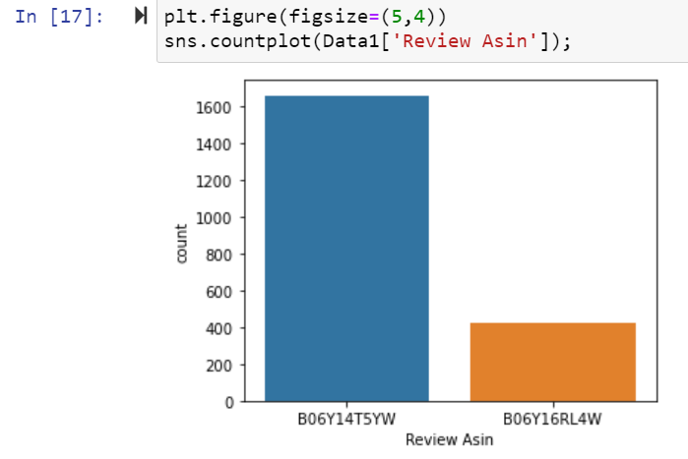
Univarient analysis of ‘Product Name’, ‘Product Rating’ and ‘Review Asin’ column in this dataset.

Slide 11
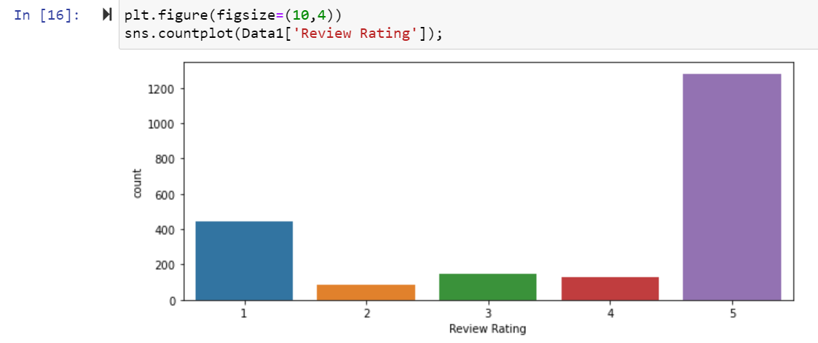
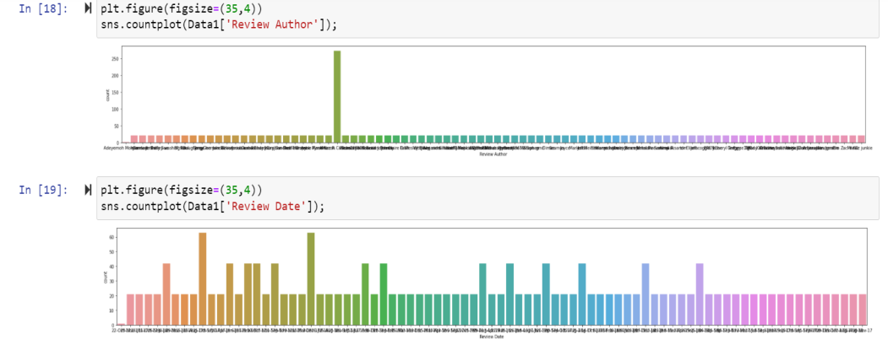
Univarient analysis of ‘Review Rating’,‘Review Author’ and ‘Review Date’ column in this dataset.

Slide 12
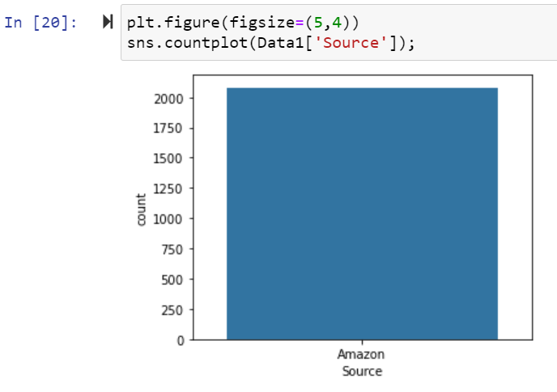
Univarient analysis of ‘Source’ column in this dataset.

Slide 13
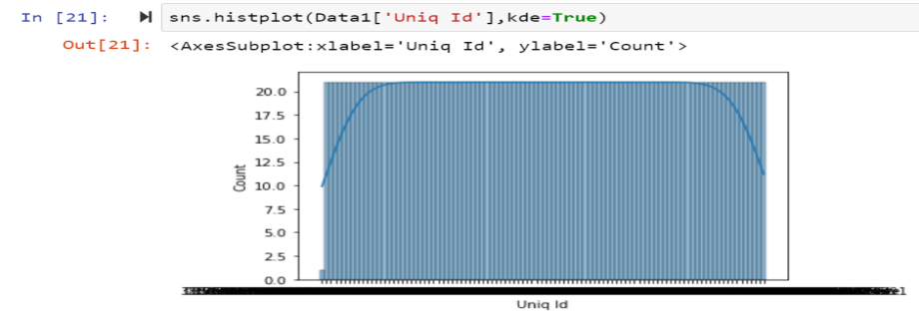
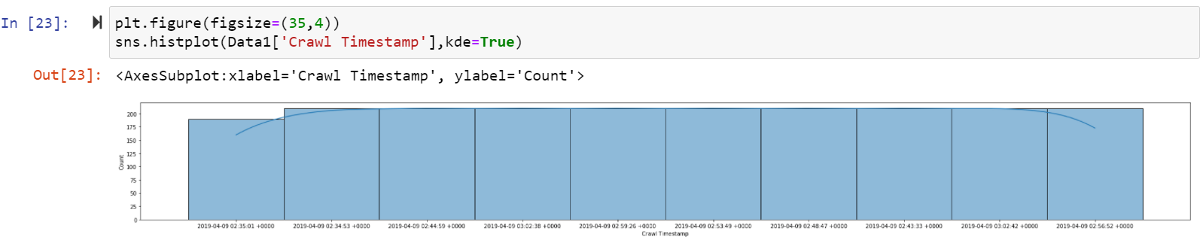
Checking Distribution of this Dataset:

Slide 14
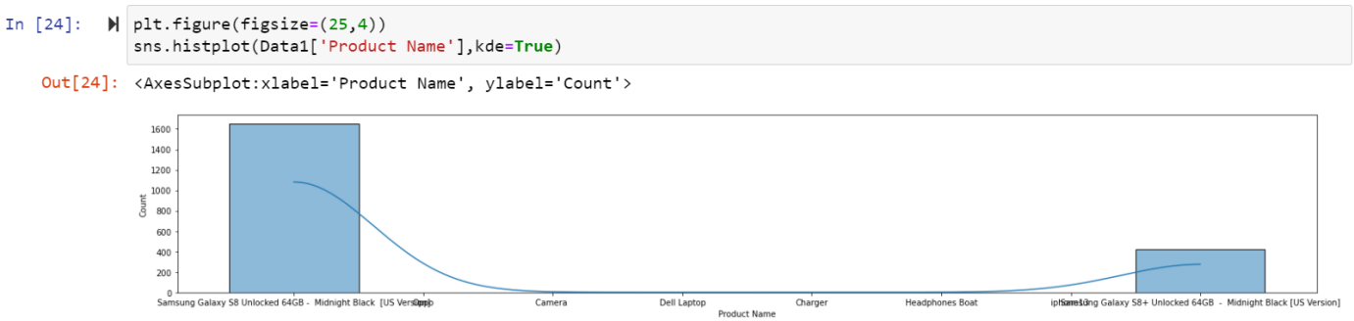
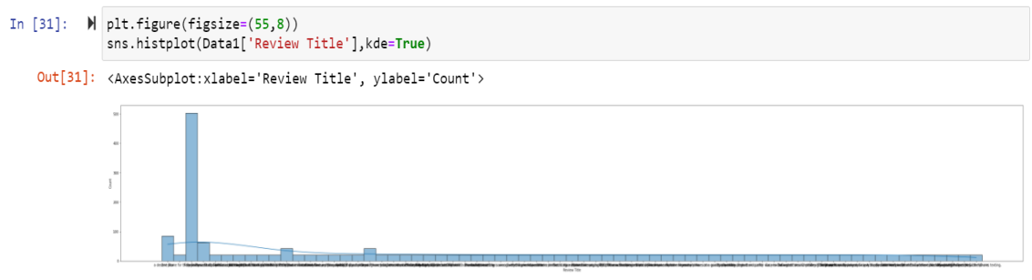

Slide 15
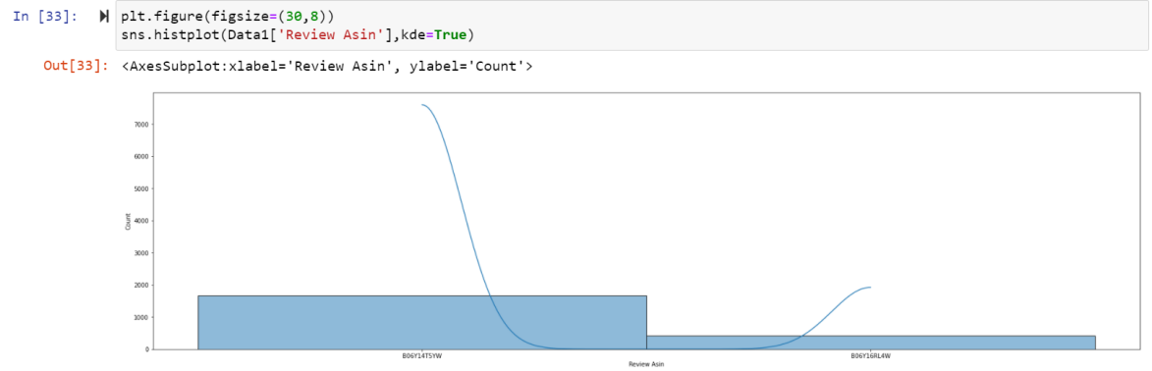
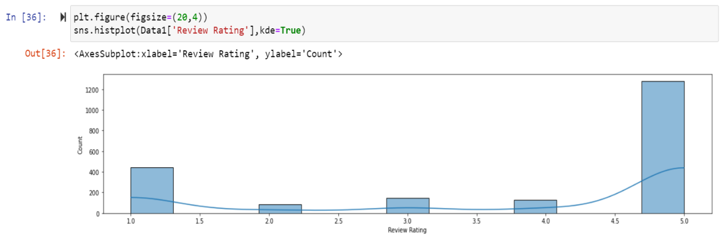

Slide 16
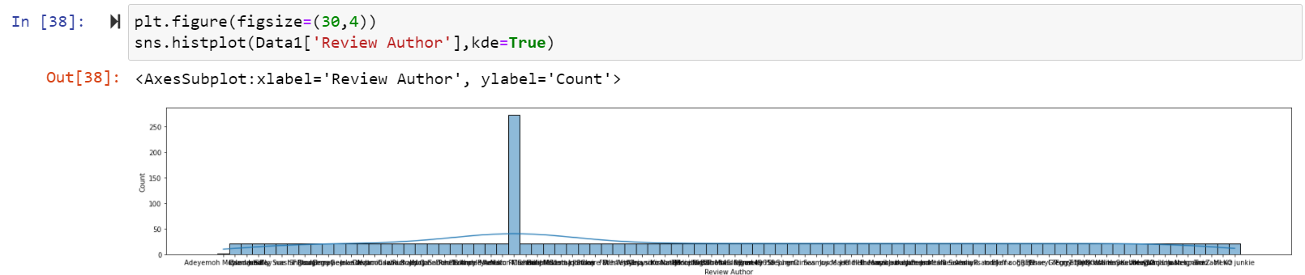
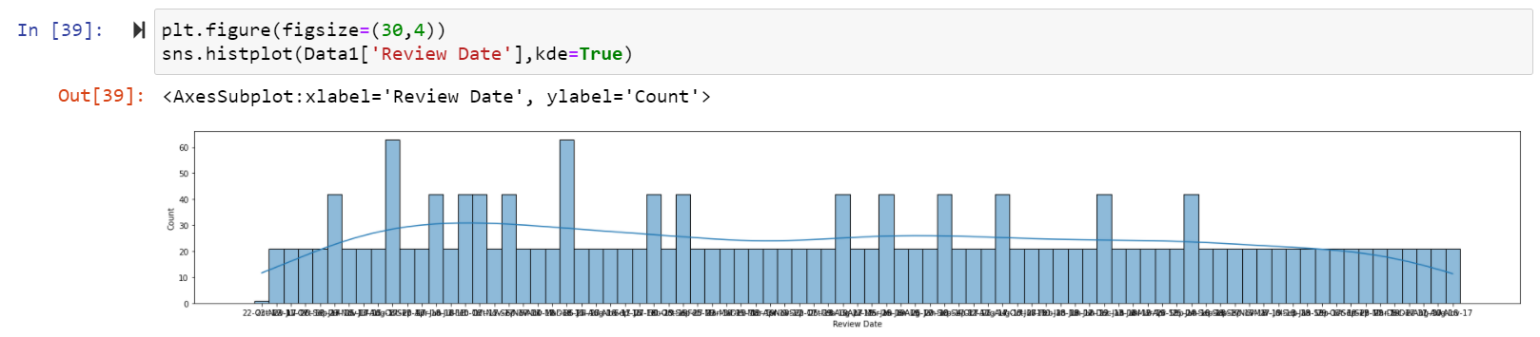

Slide 17
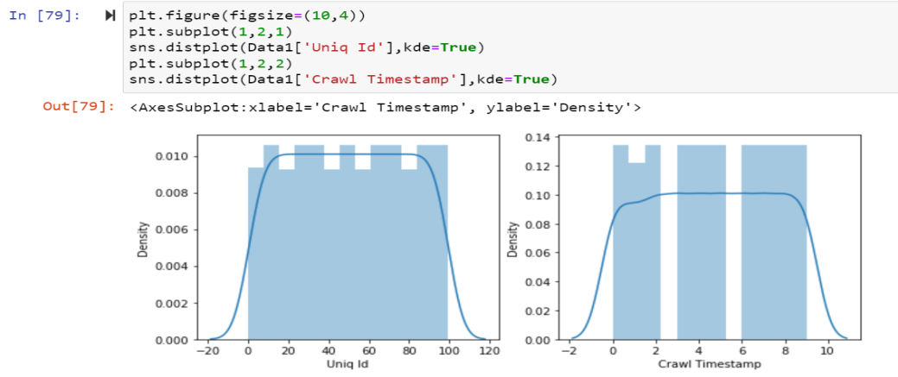
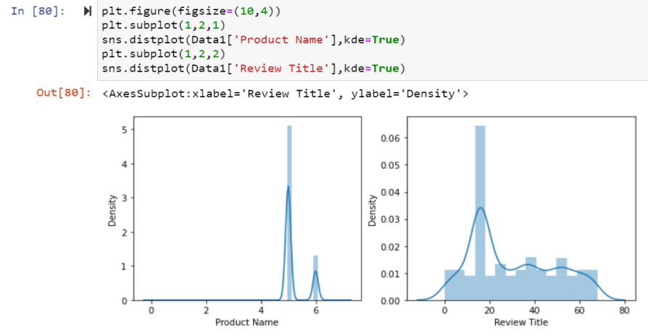

Slide 18
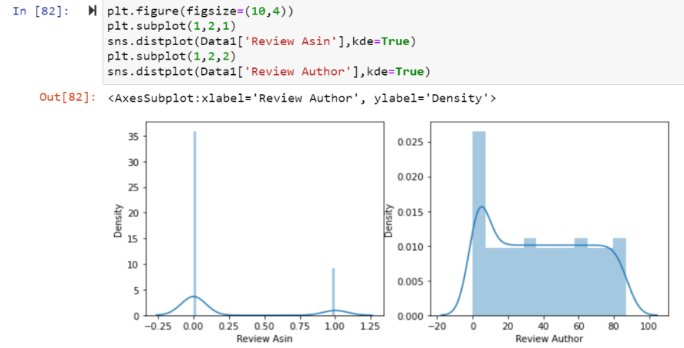
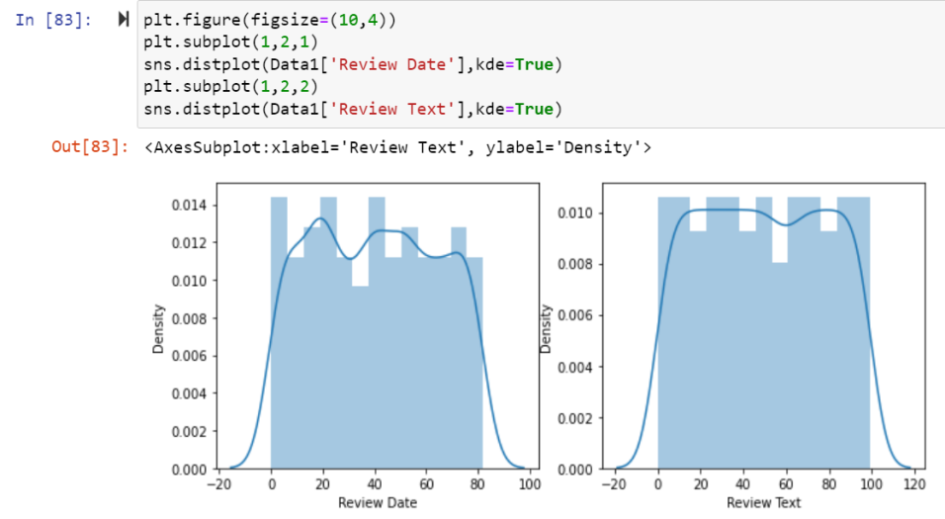

Slide 19
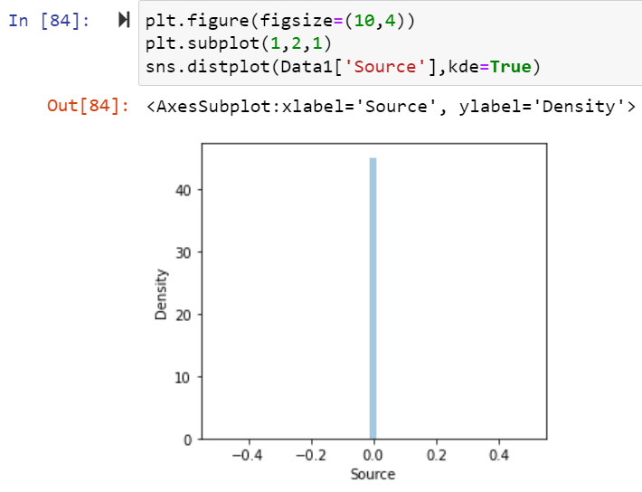
Here data columns are not normally distributed.

Slide 20
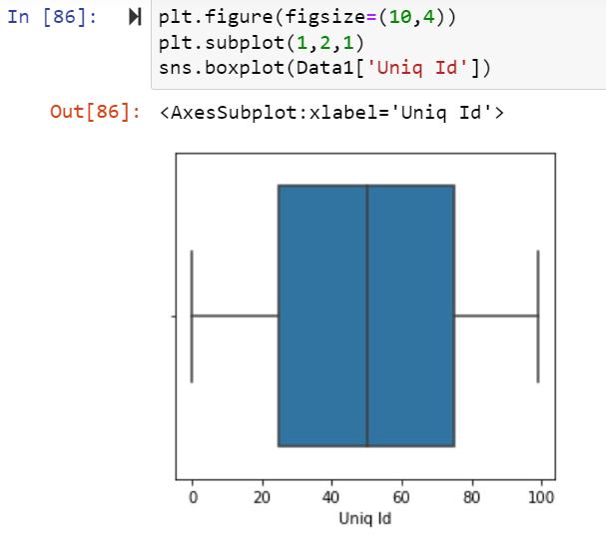
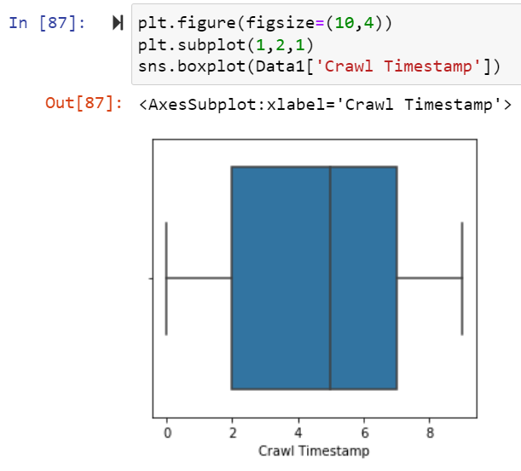
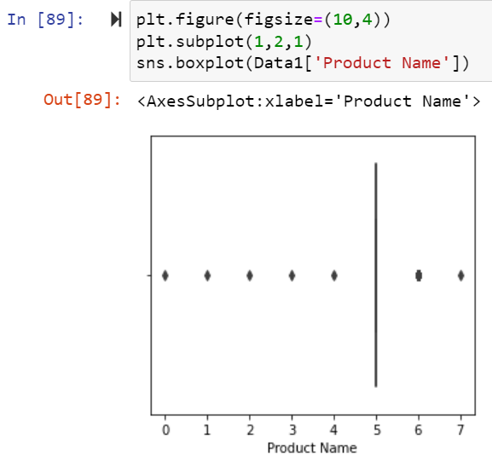
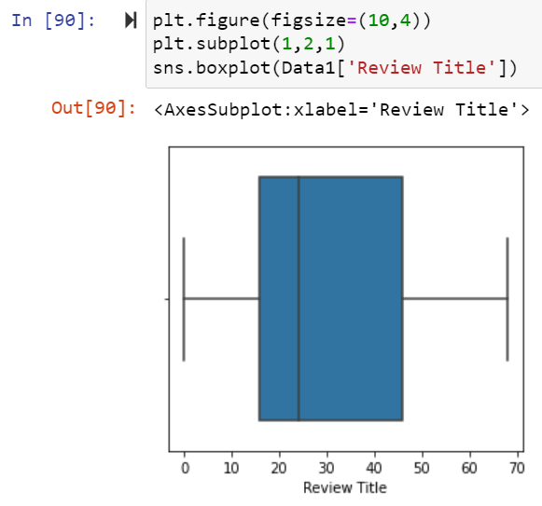
Checking Outliers of this Dataset:

Slide 21
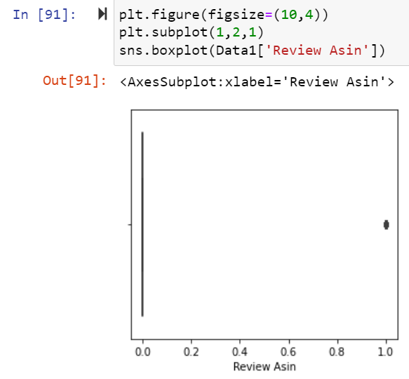
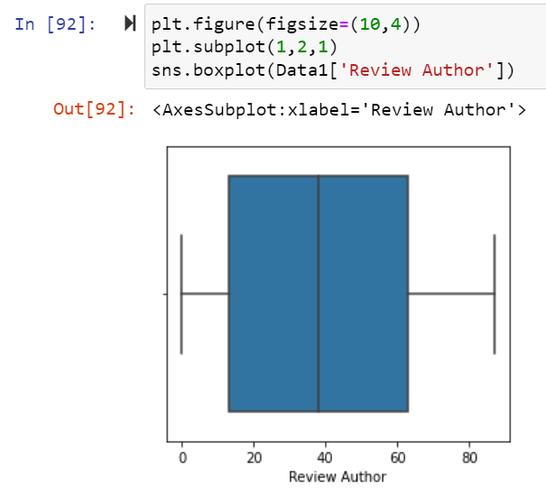
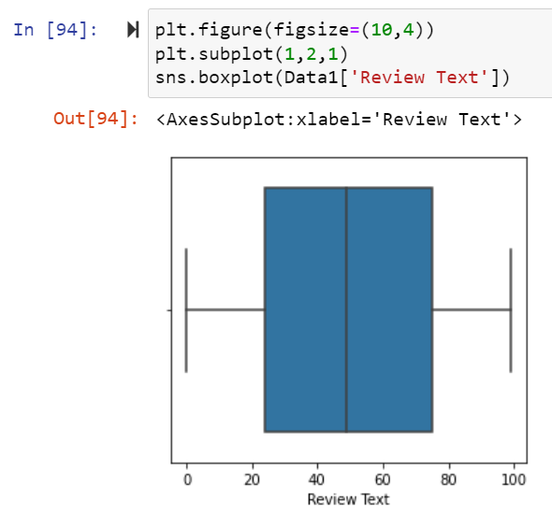
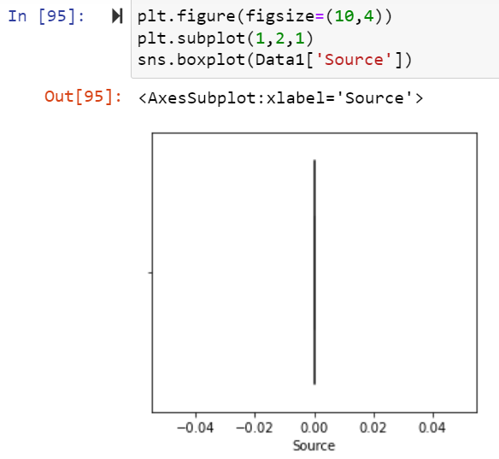

Slide 22
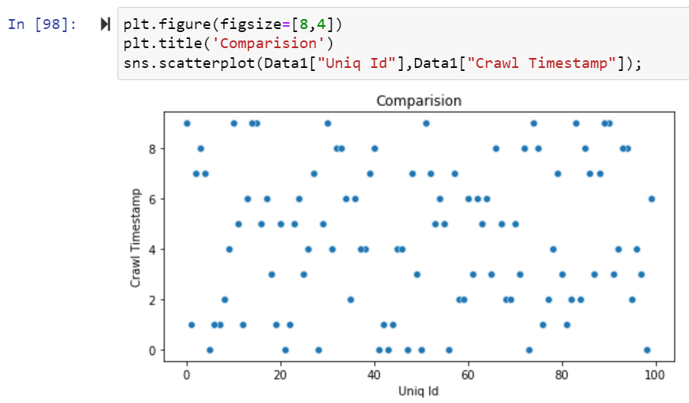
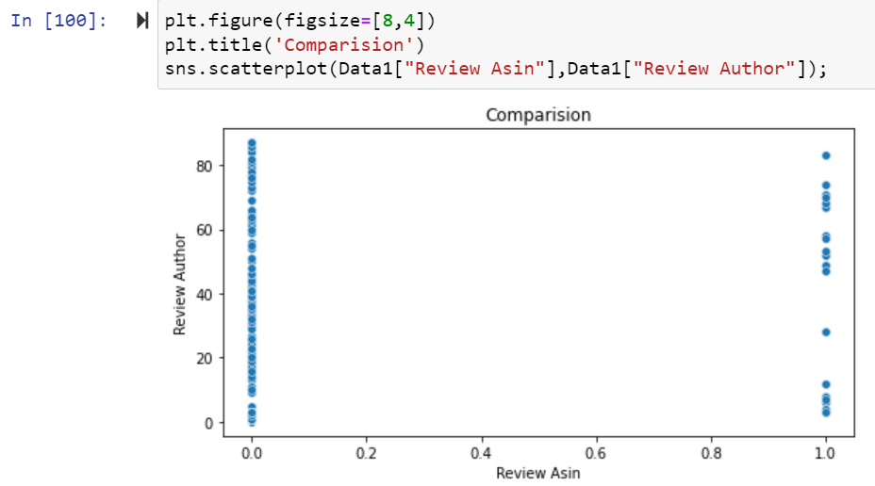
Bi varient Analysis of Train Dataset:
Scatter Plot

Slide 23
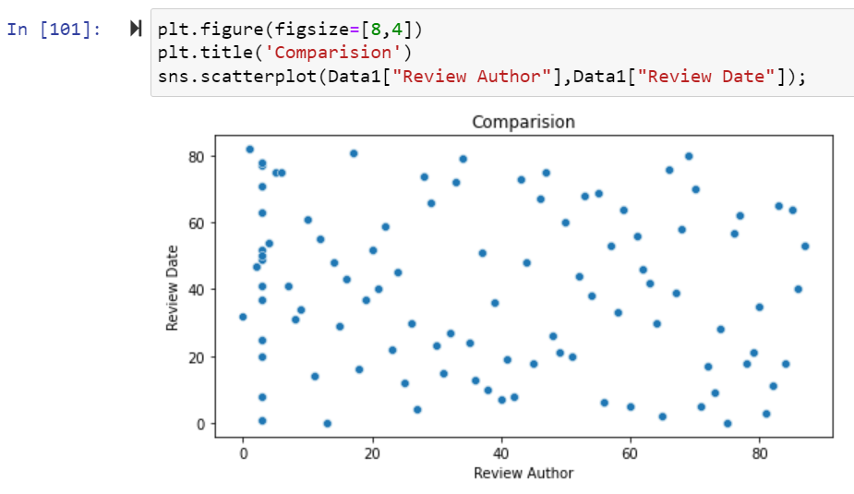
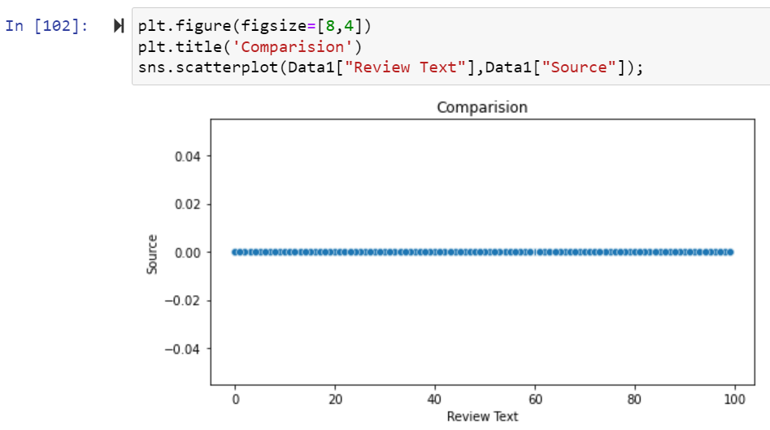

Slide 24
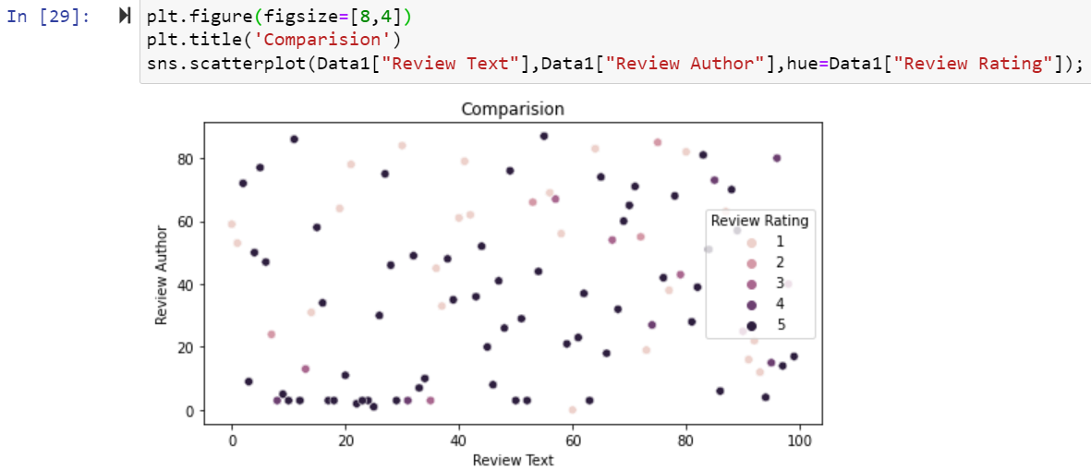
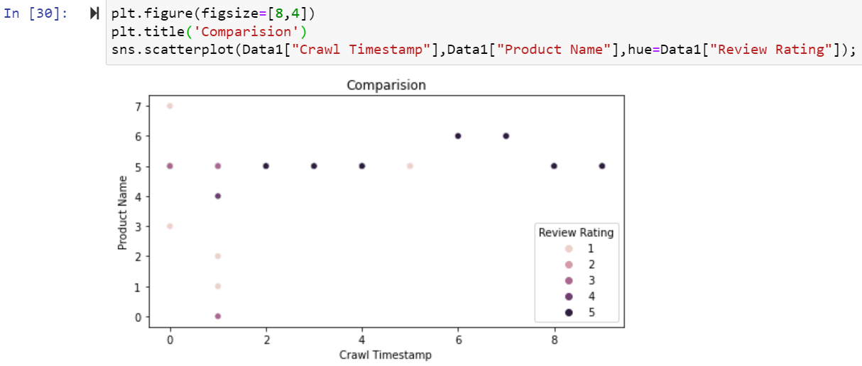

Slide 25
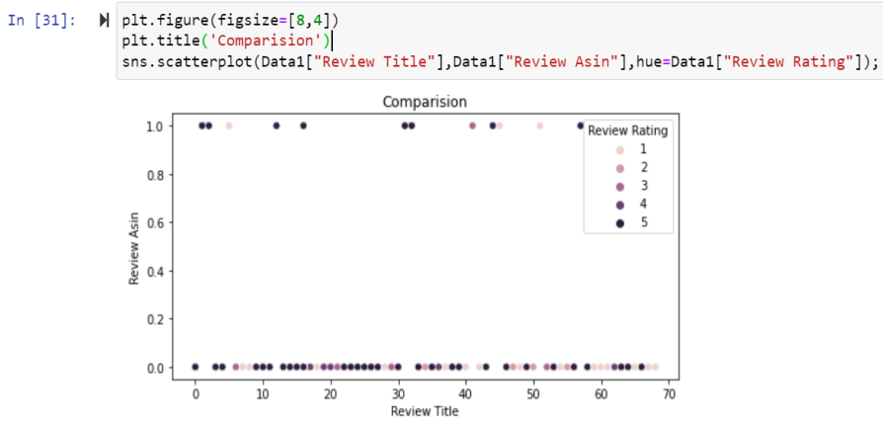
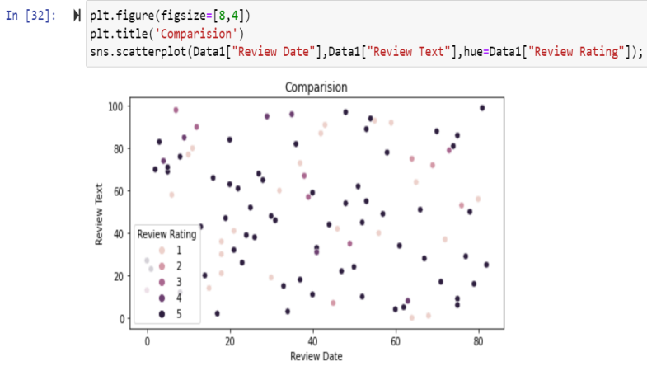

Slide 26
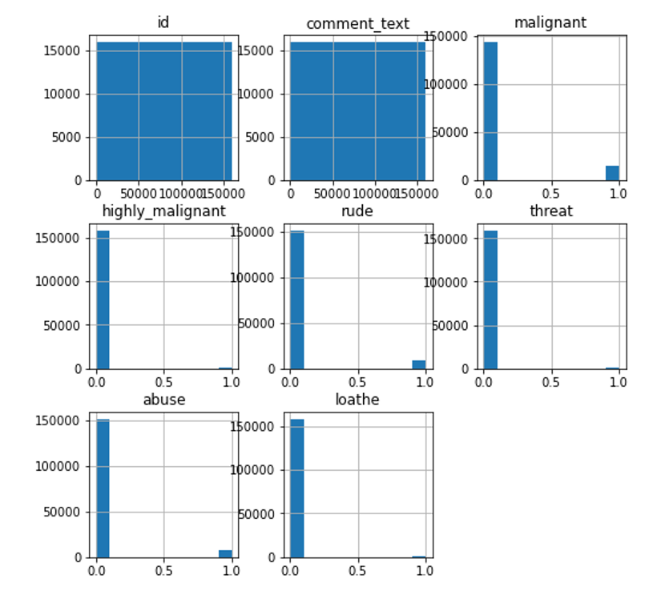
Multi Varient Analysis of the Dataset:
HistPlot:

Slide 27
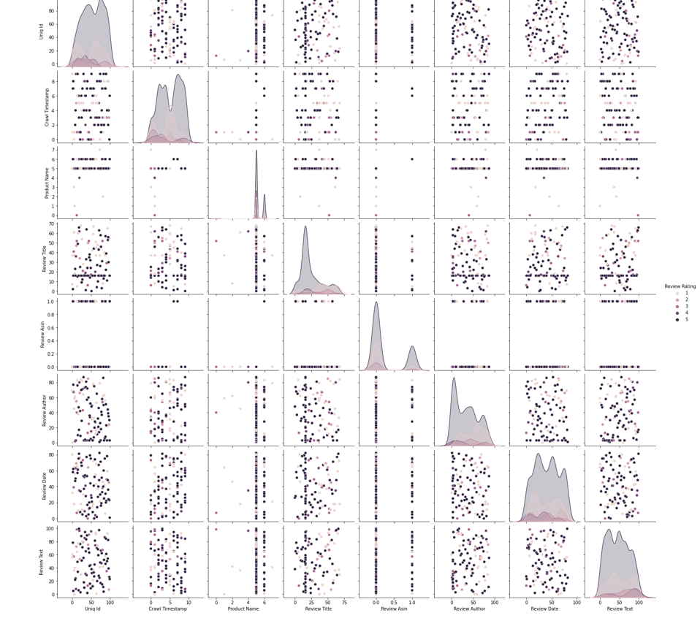
Pair Plot of this Dataset

Slide 28
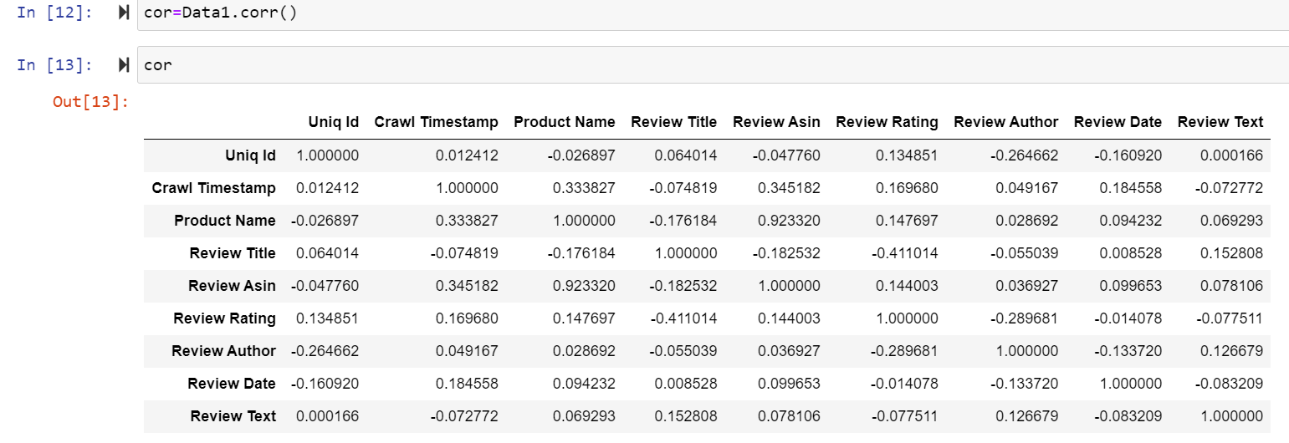
Visualizations:
Heatmap of Train Dataset:
cor=df_tr.corr()
Cor

Slide 29
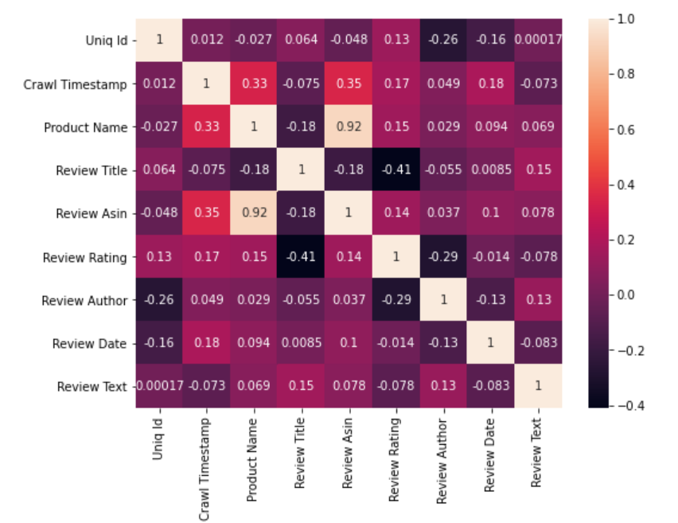
Heat map shows the correlation of every independent variable in dataset with target variable. Here above heatmap the every independent variable check correlation with this dataset.
Heat map shows the correlation of every independent variable in dataset with target variable. Here above heatmap the every

Slide 30
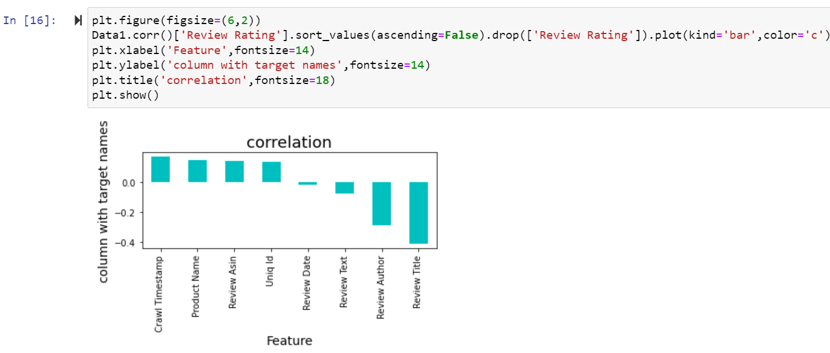
Here we shows the correlation in another way in this above we show all columns are positively correlated with target variable.

Slide 31
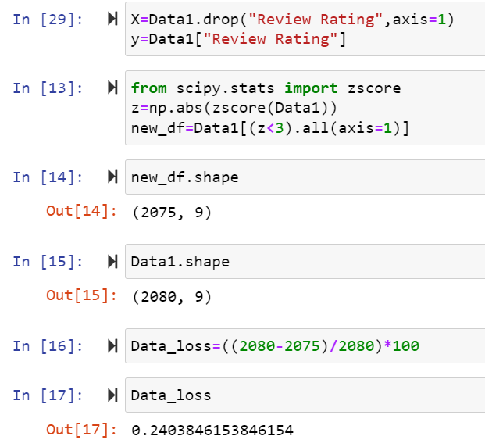
Use zScore Check the dataloss:
After that Cheking Data loss of the dataset after using preprocessing steps here using zscore method checking dataloss here after zscore there 0.2 is dataloss

Slide 32
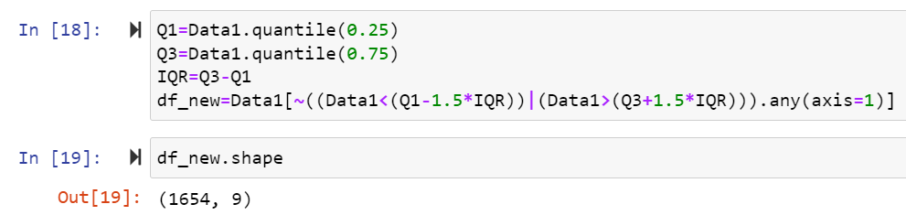
Use IQR Check the dataloss:
Here after Applying IQR method checking dataloss here using IQR method same dataloss.

Slide 33
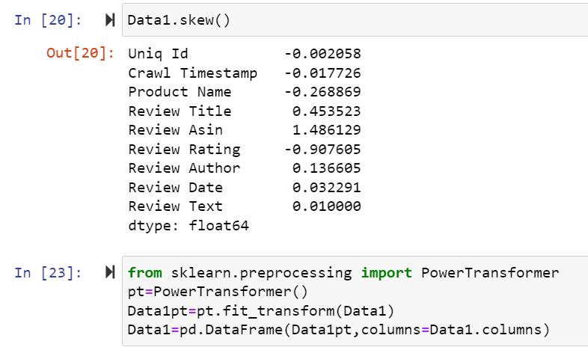

Checking Skewness:
To remove skewness use Power Transformer and log transform technique in dataset.

Slide 34


5.Building Machine Learning Models:

Slide 35


Lasso Regression:
Here r2 score is -0.002 for dataset and cross validation score is -0.0005 in Lasso algorithm.

Slide 36

Ridge Regression:
Here r2 score is 0.28 for this dataset and 0.30 cross validation score Ridge algorithm.

Slide 37

RandomForest Regression:
Here r2 score is 1.0 for this dataset and cross validation score is 99 in RandomForestRegressor algorithm.

Slide 38

SVR Regression:
Here r2 score is 0.77 for this dataset and cross validation score is 80.90 in SVR algorithm.

Slide 39

DecisionTreeRegressor:
Here r2 score is 1.0 for this dataset and cross validation score is 99 in DecisionTreeRegressor algorithm

Slide 40

AdaBoostRegressor:
Here r2 score is 0.79 for train dataset and cross validation score is 99 in AdaBoostRegressor algorithm.

Slide 41

KNN Regressor:
Here r2 score is 1.0 for the dataset and cross validation score is 99 in KNN Regressor algorithm.
Here we check r2 score and after that check cross validation score of all the model the Random forest repressor is the best model because r2 score and cross. validation score is 0.99 So apply hyper parameter tuning on it.

Slide 42

Here above are the parameter list of RandomForestRegressor model.
The above code block we have the following parameters max_features: In this maximum features there are two values auto and auto,sqrt.
n_estimator is 200 ,700 and in max_depth 4,5.

Slide 43


Slide 44

Here after use different parameter list the best parameter list is select. Above are the best parameter list RandomForestRegressor. Put this parameters into the model so output is finally best score os RandomForestRegressor is 99 so it is the best score.

Slide 45

Finally Load the model and predict the values.

Slide 46
CONCLUSION:
In conclusion, my thesis was proven to be correct. Combining the formerly known data about each user’s similarity to other users with the sentiment analysis of the review text itself, does help improve the model prediction of what rate the user’s review will get.

